Slide 1
Language Processors
In order to run /to execute/, any program written in HLL (incl. Java) should be transformed to executable form
Three ways to convert source code into executable form:
  Compiler – generate object code – see slide+1
  Interpreter – interpret source code – see+2
  Compiler of hybrid (semi-interpreting) type - +3

Slide 2
data
Source program
Object program
Executing computer
Results
compiler
Compile time
Run time

Slide 3
Data
Source program
Interpreter
Results
Compile time
Run time

Slide 4
data
Source program
Object program in IL form
Interpreter
Results
compiler
Compile1 time
Compile2 time
Run time

Slide 5
How Java works
Java compiled to intermediate form – byte code.
Byte code further processed:
by interpreter named JVM
OR
by JIT compiler.
Reminder and Refresh
The SDLC concept - see next slide
Java Programming: From Problem Analysis to Program Design, 4e

Slide 6
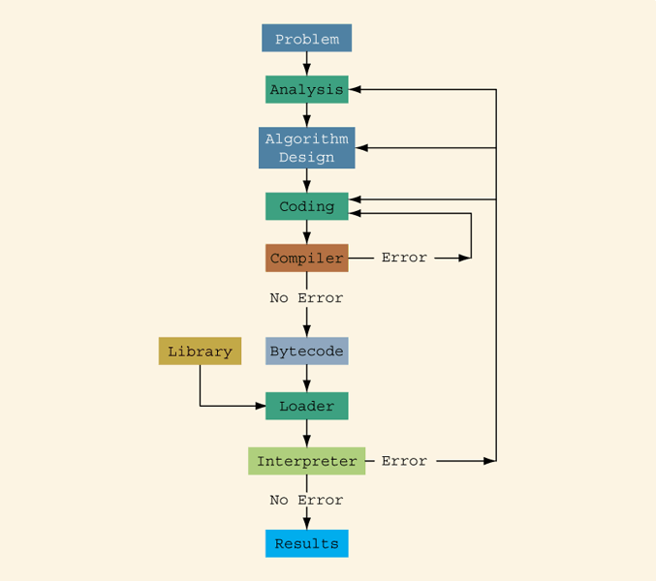
Problem-Analysis-Coding-Execution Cycle
Java Programming: From Problem Analysis to Program Design, 4e

Slide 7
Java Components of special interest
Pure Java includes 3 software facilities:
JRE (includes JVM)
JVM (a part of JRE)
JDK

Slide 8
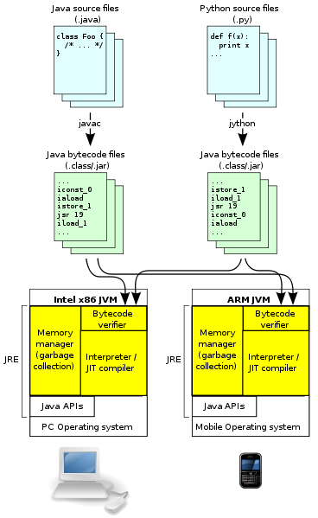
JVM
JVM architecture.
  Source code is compiled
  to Java bytecode, which
  is verified, interpreted or
  JIT-compiled for the
  native architecture.
  The Java APIs and JVM
  together make up the
  Java Runtime Environment
  (JRE).

Slide 9
JDK contents
The JDK has
as
its primary components
a collection
of programming tools,
including:

Slide 10
JDK contents (most often used utilities)
appletviewer – this tool can be used to run and debug Java applets without a web browser
java – the loader for Java applications. This tool is an interpreter and can interpret the class files generated by the javac compiler.
javac – the Java compiler, which converts source code into Java bytecode
javadoc – the documentation generator, which automatically generates documentation from source code comments
jar – the archiver, which packages related class libraries into a single JAR file. This tool also helps manage JAR files.

Slide 11
A Simple Java Program
Listing 1.1
//This program prints message “Welcome to Java!“
// braces in end-line style
public class Welcome {
public static void main(String[] args) {
System.out.println("Welcome to Java!");
}
}
Notes:
Source: Longman dictionary 1987

Slide 12
A Simple Java Program
Listing 1.1
//This program prints message “Welcome to Java!“
// braces in new-line style
public class Welcome
{
public static void main(String[] args)
{
System.out.println("Welcome to Java!");
}
}
Notes:
Source: Longman dictionary 1987

Slide 13
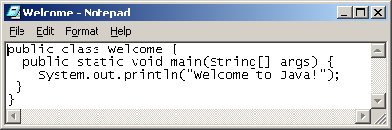
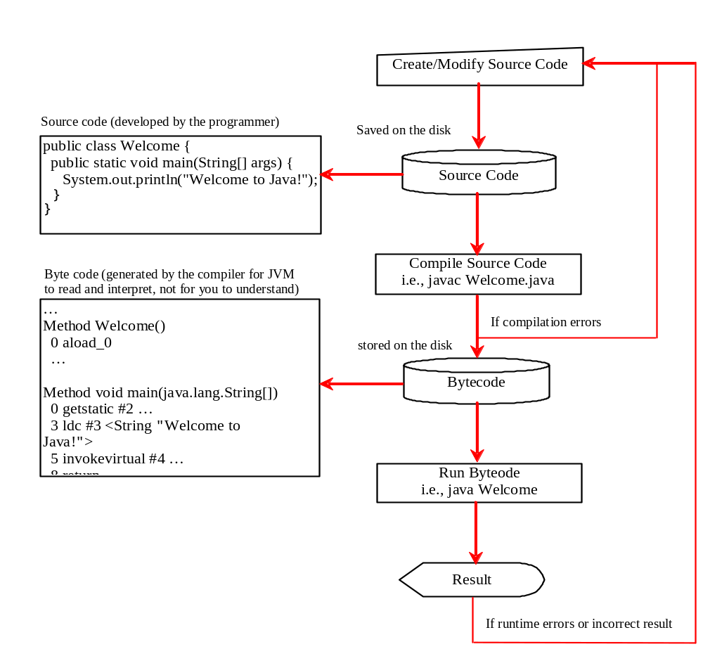
Creating, Compiling, and Running Java Programs

Slide 14
Running JAVA in
Windows Environment

Slide 15
Creating, Compiling & Running
Java Programs
From the Command Window
  Details follow

Slide 16
To open command window
  Click Start
  Select All Programs >
  Select Accessories
  Click Command Prompt

Slide 17
Compiling and Running Java programs
Using any text editor , /notepad, edit, write/ type the source text of a Java demo program like this:
public class prog4 {
public static void main(String[] args){
System.out.println("Hello from Java");
}
}
Save the Java program as a prog4.java file.

Slide 18
Compiling and Running Java programs
Run compiler with statement like this:
javac prog4.java
Run application with stmt like this:
java prog4

